Slide 1




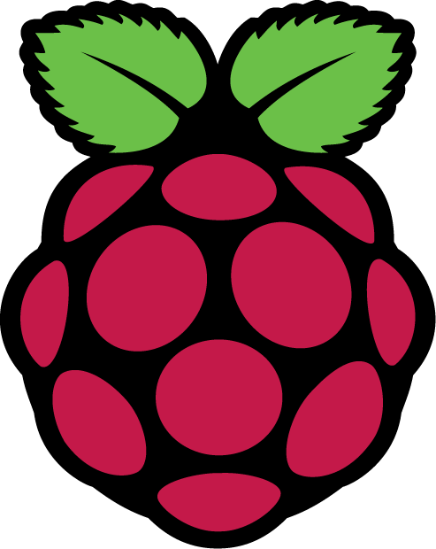
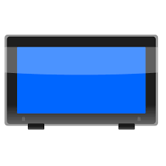

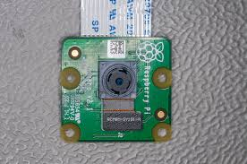
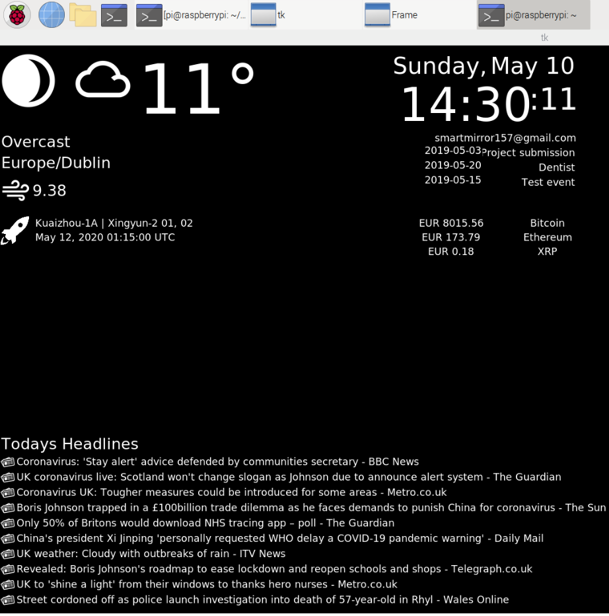
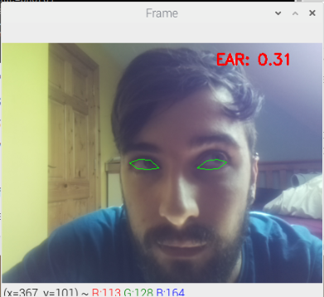
Smart Mirror with Drowsiness Detection
By Evan Carr
B.Eng. (Hons) Software & Electronic Engineering
API Information
Introduction
Features
The Smart Mirror is a Mirror that displays widgets on the face of the mirror such as Time, date, weather, news headlines and others,
It consists of an LCD screen covered with highly reflective acrylic material all placed in a wooden frame.
It also uses a pi camera and OpenCV to detect if the person looking at the screen is drowsy or falling asleep and will play an alarm sound if the users eyes are closed for too long.
Request & Receive API Information
Displays various information such as time, date, news etc.
Detects tiredness from a user looking at the mirror using OpenCV.
Plays an alarm if users eyes are closed for too long i.e. if they are asleep.
Also functions as a mirror.
JSON
Raspberry pi
Display Mirror
Results
Technologies
Input stream for drowsiness detection
Python all GUI code for widgets and OpenCV is written in python.
OpenCV used dlib’s facial landmark identifier to measure and calculate eye aspect ratio to detect whether the users’ eyes are open or closed.
JSON used to parse API data to display on screen.
Raspberry PI the mirror is powered by the Pi and all code is running on the Pi.
LCD Monitor to display code.
Pi Camera used to read from user.
Pi Camera
The above images show the final layout of the mirror GUI on the left without acrylic.
And the output of the OpenCV code running on the right with green circles identifying the eyes and the eye aspect ratio shown in red

